Slide 1
Which animals are most likely to get adopted in Texas?
Allison Forte
DSC 530 Final Project
June 3, 2022

Slide 2
The foundation
Thousands of animals sit in animal shelters across the country awaiting their fate. Animals of many breeds, ages, and sexes are mixed hoping to find their forever home. Many variables play into the outcome for each individual but perhaps we can identify common traits that make an animal more adoptable or, on the other hand, more likely to be destined for euthanasia.
This exploratory data analysis project will begin this research by looking at 2 data sets from a particular animal shelter in Austin, Texas to identify which measurable traits most significantly impact an animal’s chances of making their way out of an animal shelter.

Slide 3
The questions
In Austin, Texas, what is the breakdown of types of animals at this particular shelter?
How long is the average stay in this animal shelter?
Which animal type is most likely to be adopted? And euthanized?
At what age are most animals adopted? Does this differ by species?
Which sex is most likely to be adopted? And euthanized?

Slide 4
The data: Joined by animal ID
Austin Animal Center Intakes: A CSV with 135,601 entries, each for a unique animal taken in by the shelter. There are 12 variables
Variables that could impact the research questions include animal ID, date of intake, intake type and condition, animal type, sex and age at intake
Austin Animal Center Outcomes: A CSV with 128,659 entries, each for a unique animal that left the shelter. There are 12 variables
Variables that could impact the research questions include animal ID, date of outcome, outcome type and subtype, animal type, sex and age at outcome

Slide 5
The variables: Intake
Date of intake: The date animals were taken in (Oct 2013–Jan 2022)
Intake type: Abandoned, euthanasia request, owner surrender, public assist, stray, wildlife
Intake condition: 15 descriptions of the intake type
Animal type: Categorical variable indicating Bird, Cat, Dog, Livestock, or Other
Sex at intake: Categorical variable indicating male or female and neutered or not
Age at intake: Ranging from -3 (!) to 30 years old

Slide 6
The variables: Outcomes
Date of outcome: The date of the outcome for each animal (Oct 2013–July 2021)
Outcome type: Adoption, died, disposal, euthanasia, missing, relocate, return to owner, RTO-adopt, transfer
Outcome subtype: 23 descriptions of why or how the outcome happened
Animal type: Categorical variable indicating Bird, Cat, Dog, Livestock, or Other
Sex at outcome: Categorical variable indicating male or female and neutered or not
Age at outcome: Ranging from -3 (!) to 25 years old

Slide 7
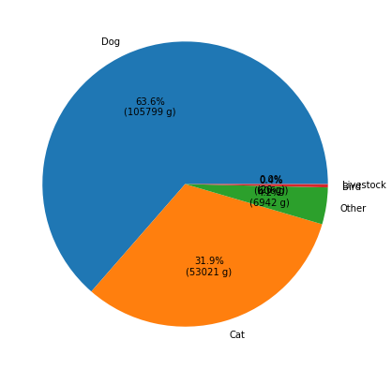
The variables: Animal type
63% of all animals taken in by this shelter were dogs and another 31.9% of the animals were cats
Relatively few other types of animals were taken in accounting for less than 5% of the total animals. It should be considered that these other animals could skew the age range (birds and reptiles have a significantly longer life span than dogs and cats)

Slide 8
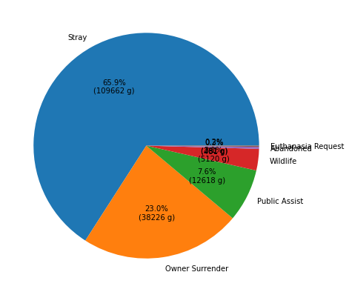
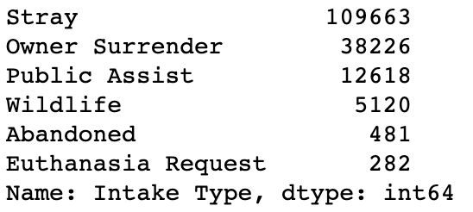
The variables: Intake type
Most animals taken in were strays (65.9%). The next largest group was owner surrenders (23%)
A very small percent of animals taken in were abandoned or euthanasia requests
The data can be seen in a graph and with detailed counts.

Slide 9
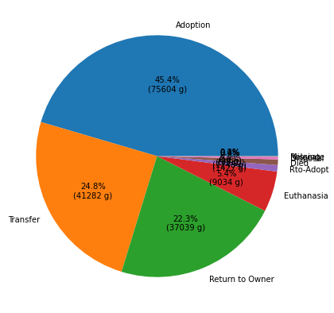
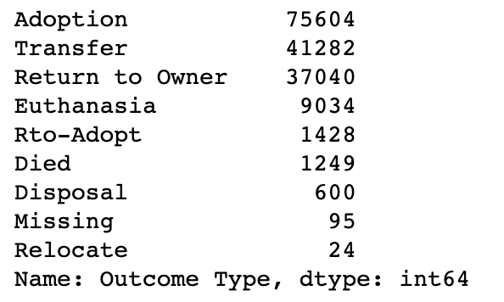
The variables: Outcome type
The most common outcome was adoption (45.4%)
Rto-adopt, died, disposal, euthanasia, missing, relocate, and RTO-adopt were the fewest outcomes making up less than 2.5% of all outcomes combined

Slide 10
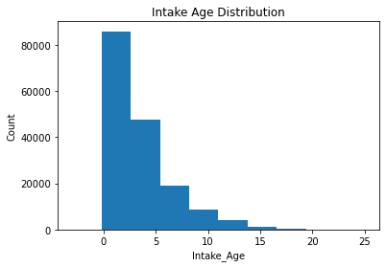
The variables: Age at intake
The majority of animals arriving at the shelter are 0-3 years old
The range is from -3 to 30 years old
Animals cannot have a negative age and so the few outliers that are less than 0 should be removed

Slide 11

The variables: Age at outcome
As would be expected based on intake age, most animals have an outcome age of 0-3 years
The range on this variable is -3 to 25 years old
The outliers that are less than 0 should be removed

Slide 12
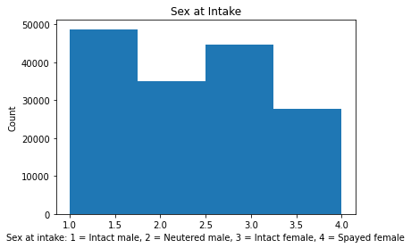
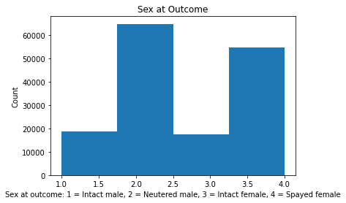
The variables: Gender
Coding the intake gender into 1-4 we can see the distribution. More intact males are taken in than any other gender
The comparison of intake to outcome shows that the shelter spayed or neutered animals before placing them in a new home. Relatively few animals were still intact at their outcome

Slide 13
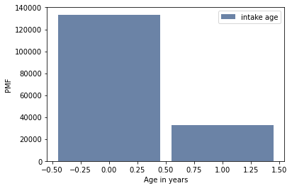
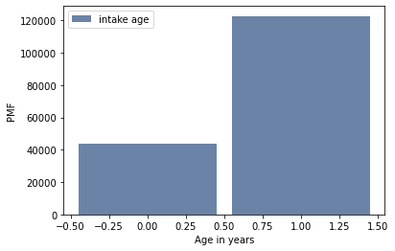
PMFs for 2 scenarios: Intake > 5, Intake <5

Slide 14
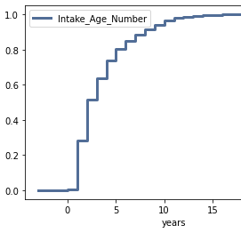
CDF: Intake age
The CDF of Intake age shows that most animals enter the shelter under 10 years of age
Less than 10% of animals taken in by the shelter are over 10 years old

Slide 15
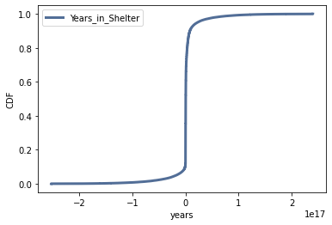
CDF: Calculated years in shelter
Data was manipulated to calculate years in shelter
The CDF of this data shows that stays at the shelter are short.
The negative stay length highlights an error in the data.

Slide 16
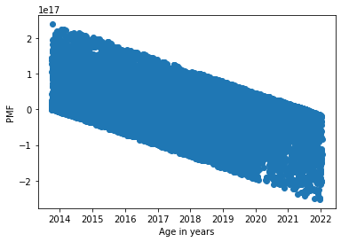
Scatterplot: Date of intake vs Years in shelter
The scatter plot reveals a strong negative relationship between intake date and length of stay
This plot highlights an issue: Many of the stays are negative
This could be because the data was not cleaned properly and it is showing results for animals who are still at the shelter or there are many data entry errors
The shelter could also be intentionally trying to reduce the stay length

Slide 17
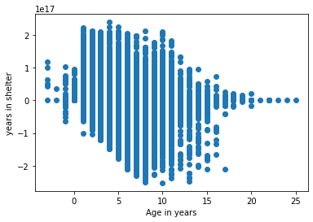
Scatterplot: Age at intake vs Calculated time in shelter
This scatterplot shows a negative relationship between age at intake and calculated age
We cannot declare causation from a scatterplot, but we can see that animals who were older at intake likely stayed a shorter time in the shelter

Slide 18
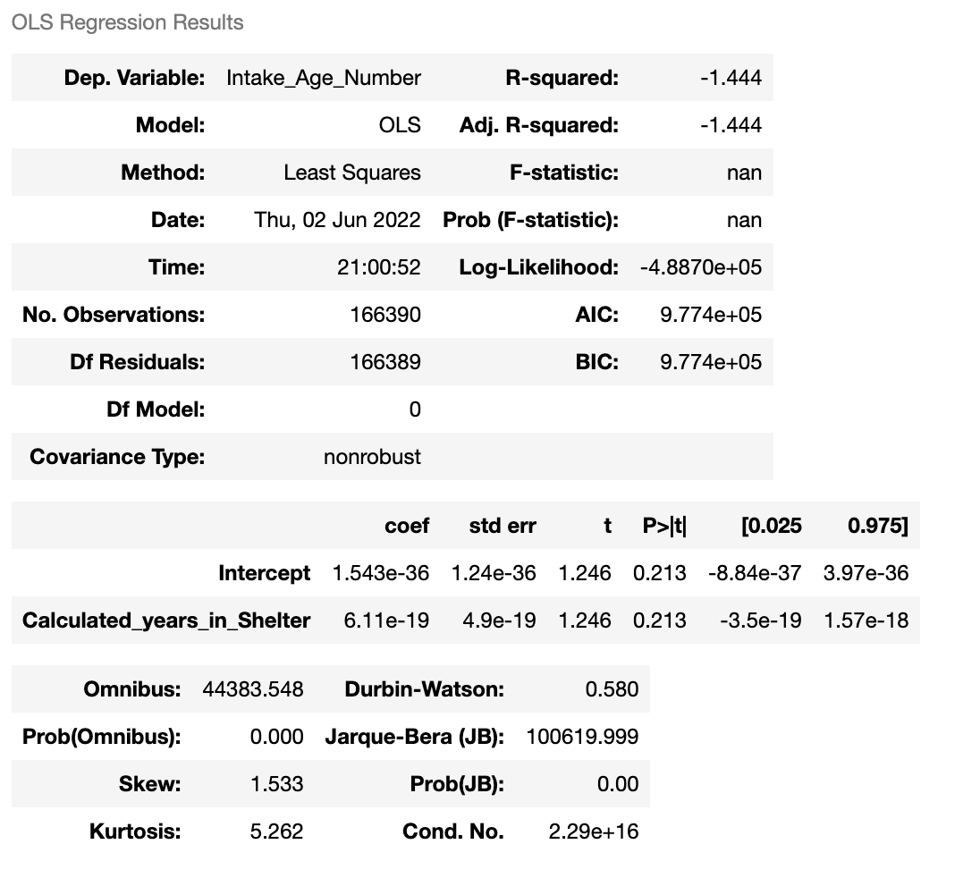
Regression analysis
A regression analysis looking at how intake age relates to calculated years in shelter (date of outcome-date of intake) provided the displayed statistics
There is a negative relationship, but the relationship is not particularly strong

